Slide 1
Tool Share - R1
tigerPaws - Group 6
Carlos Garcia-Dubus, Development Coordinator
Ivan Tactuk, Requirements Coordinator
Robert McCartney, Team Coordinator
Rohan Tilekar, Configuration & QA Coordinator
Yue Hua, Test Coordinator

Slide 2





One Group One Thinking

Slide 3


Introduction
ToolShare app
Intended to improve communities by providing an easy mechanism for sharing items between neighbors
Communities will be able to share tools by zipcode
Sharing from home or community shed
Aesthetic and user-friendly UI

Slide 4







Technologies

Slide 5
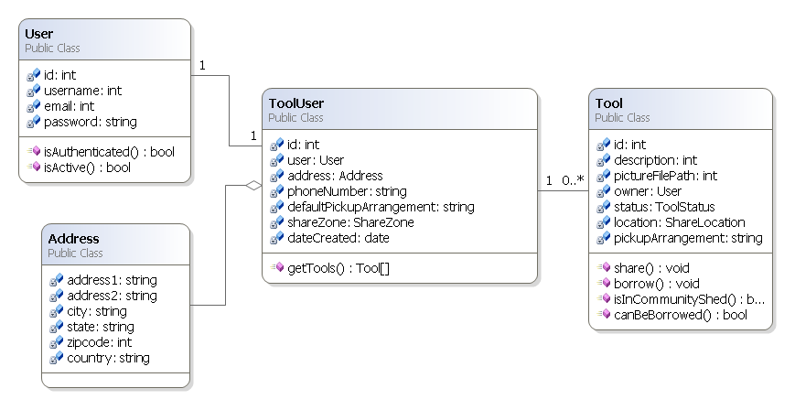
Design Class - Diagram

Slide 6
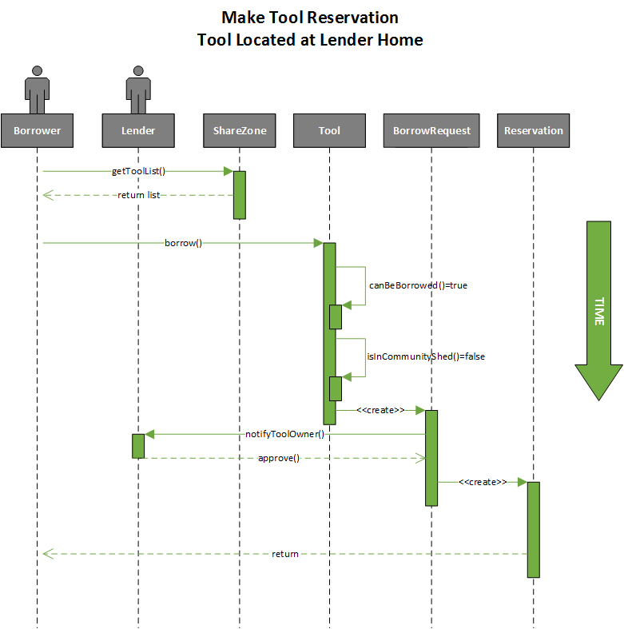
Sequence Diagram

Slide 7
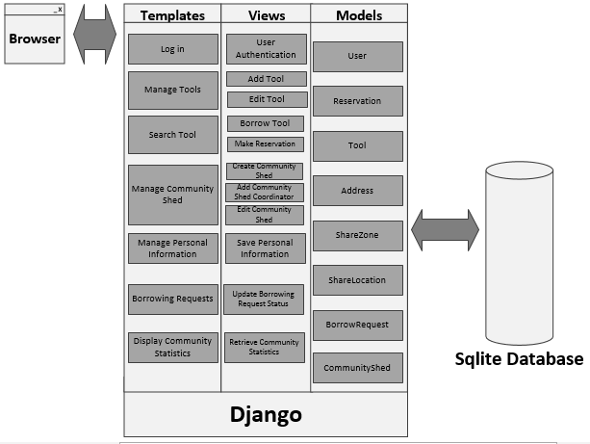
Architecture Overview
Python 3.4
Django 1.6
django.contrib.auth.models
django-bootstrap3
django-localflavor
usa states
zipcode validation
django-image
django-registration
south
database migration
PyCharm
SQlite

Slide 8
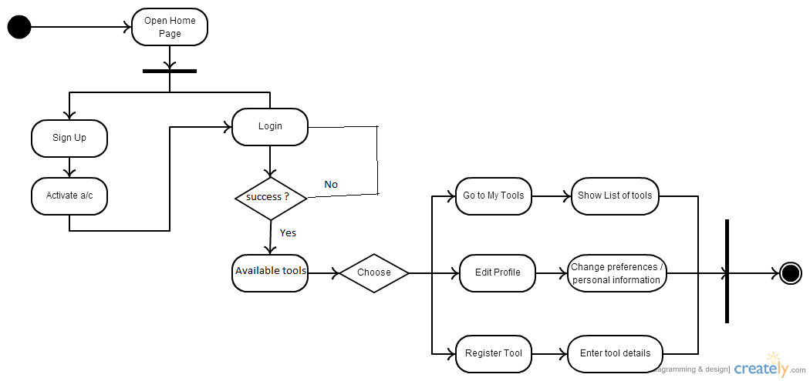
Current Features Implemented

Slide 9
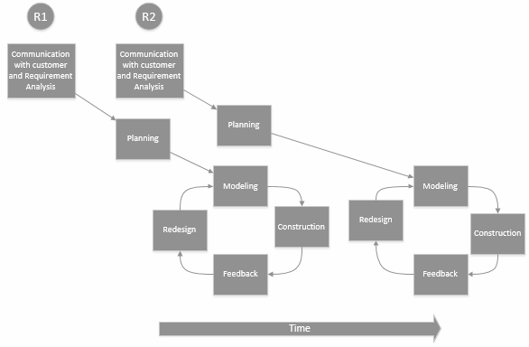
Process
Weekly meetings and assignments
Combination of iterative and evolutionary process
Full-team coding sessions

Slide 10
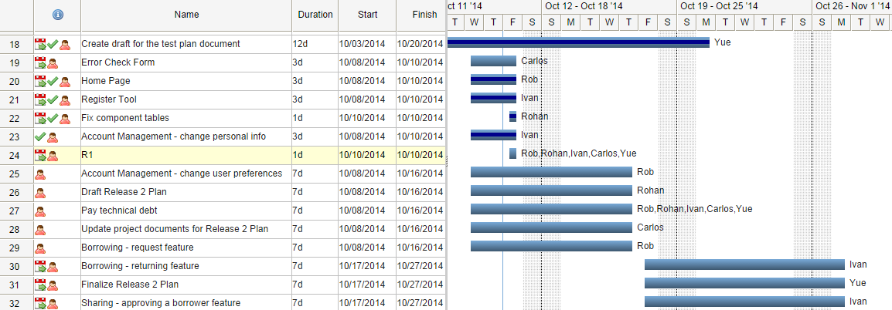
Project Management

Slide 11

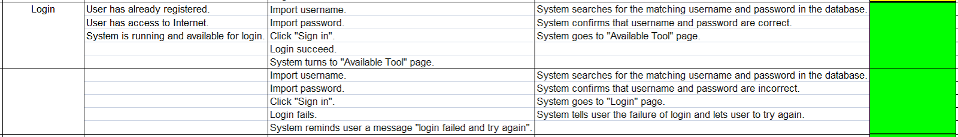
Testing

Slide 12
Demo

